Slide 1
CGB1201 – JAVA PROGRAMMING PROJECT
Department of Artificial Intelligence and Data Science
Academic Year: 2024 – 2025 (Odd Semester)
Register Number : 2303811724322083
Name : PRAVEENA V
Year : II
Semester : III
Section : B
Date : 3.12.2024

Slide 2
Title of the Project
NUMBER GUSSESING GAME

Slide 3
Problem Identification
The Number Guessing Game creates an interactive system for users to guess a randomly generated number within a specified range. It ensures proper input validation, real-time feedback, and user-friendly gameplay.

Slide 4
Objective
The objective of the Number Guessing Game is to develop an interactive application where users can guess a randomly generated number within a specified range. The game provides real-time feedback on guesses and tracks the number of attempts. It aims to enhance logical thinking and demonstrate efficient GUI programming techniques.

Slide 5
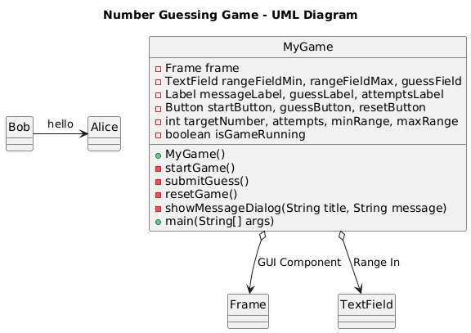
Proposed Architecture

Slide 6
Java Programming - Concepts Used
Object-Oriented Programming (OOP): Encapsulatesof game logic in the MyGame class
AWT (Abstract Window Toolkit): For creating the GUI components (e.g., Frame,Panel,Label,Button TextField).
Event Handling:Using ActionLinster and WindowAdapater to user interactions like button clicks and window events.
Random Number Generation: Using java.util.Random to generate the target number
GridBagLayout: Organizes UI components in a flexible, grid-based layout for better positioning.

Slide 7
List of Modules
Range Input Module
Game Logic Module
Event Handling Module
Graphical User Interface(GUI) Module
Reset Module

Slide 8
Module Description
Range Input Module: The Minimum and Maximum Value for the game using text field,validates them, and initializes the game with “start Game” button
Game Logic Module:The game generates a target number and gives feedback on guesses until correct

Slide 9
Module Description (Cont..)
Event Handling Module: Handles actions for starting, guessesing , and resetting the game through button click listeners
Graphical User Interface Module: The GUI module creates and organizes the user interface with input fields, buttons,labels, and panels for interacting with the game

Slide 10
Module Description (Cont..)
Reset Module:The reset module clears inputs,resets the game state , and upates the ui to its initial state

Slide 11
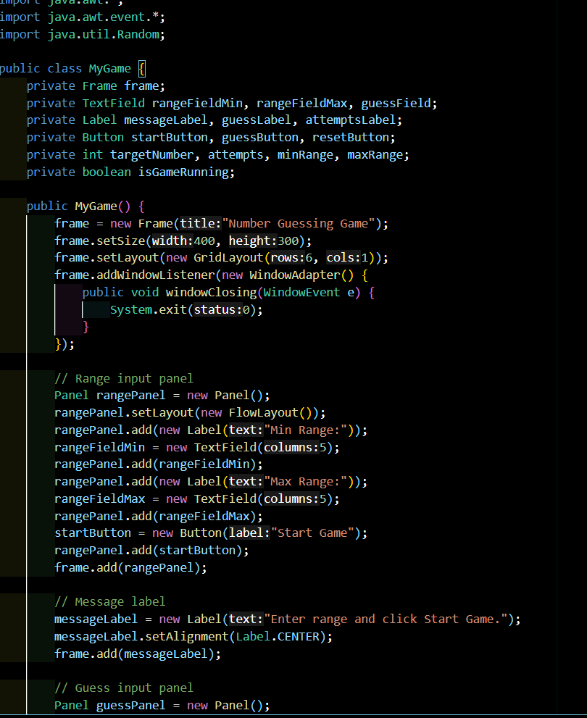
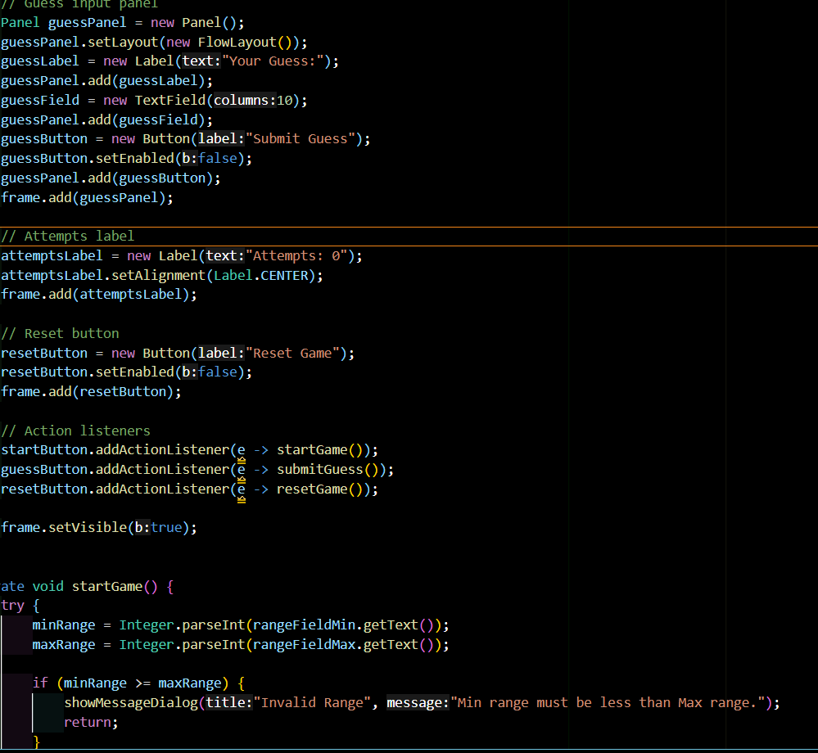
Source code

Slide 12
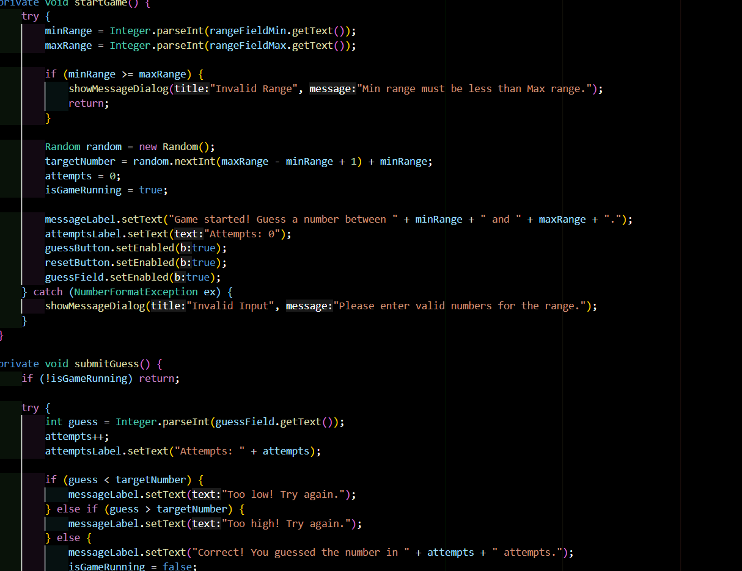
Source code

Slide 13
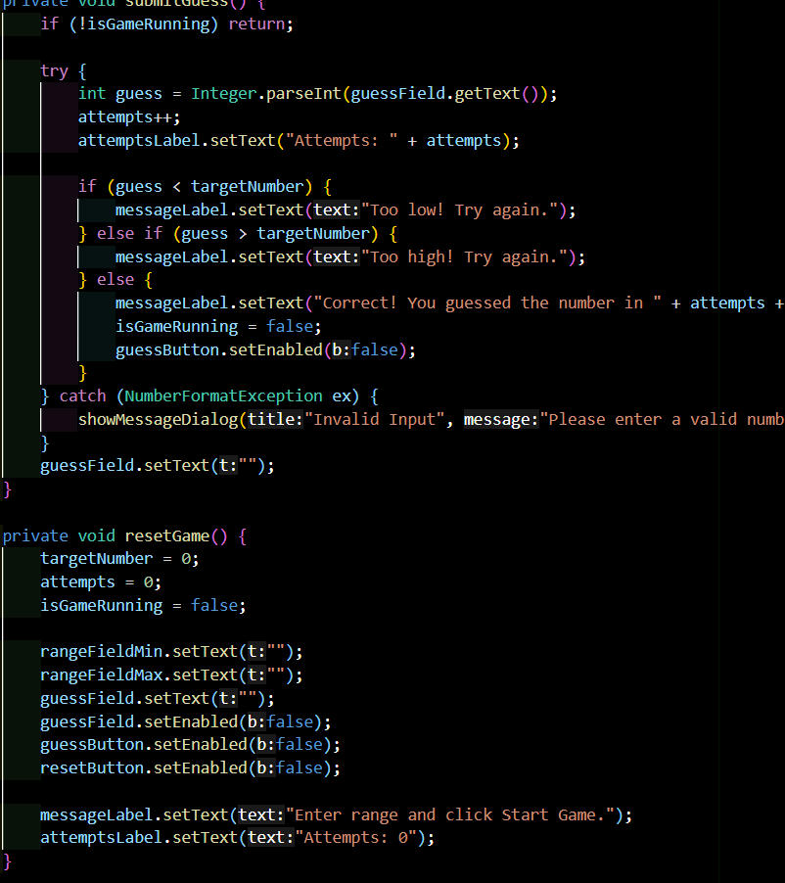
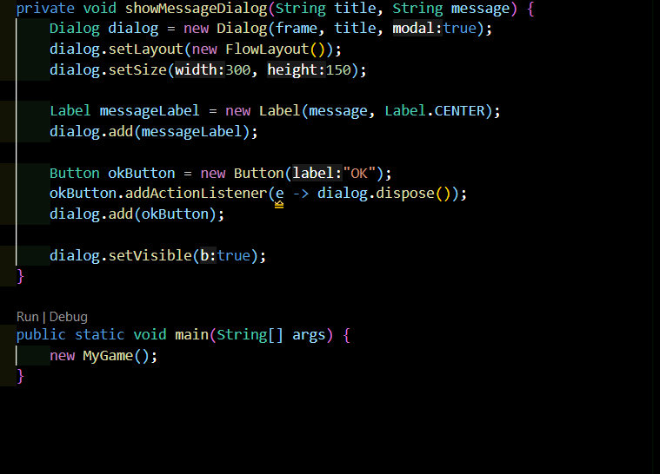
Source code

Slide 14
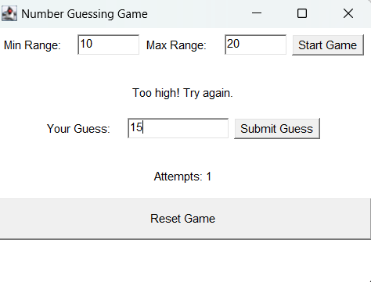
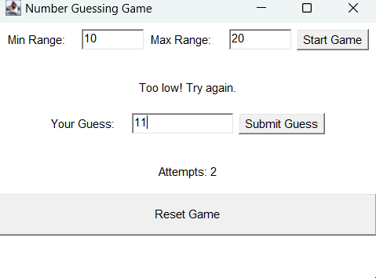
Results

Slide 15
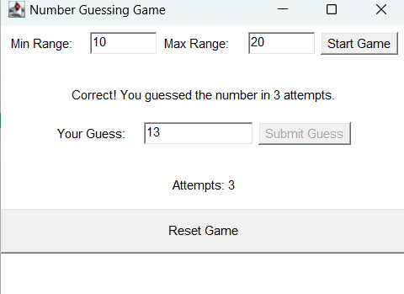
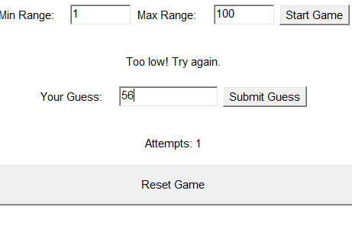
Results

Slide 16
Conclusion
The program is a simple yet engaging number guessing game
with a user-friendly GUI, robust input validation, and modular design, making it easy to play and extend.

Slide 17
Thank You
Any queries???

